Slide 1
Name: Aakanksha Aaba Deore Batch Name: FST Ml-9 Class: TYBsc-cs Mentor: Ashwini Kakde Mam

Slide 2


Project Name:
Gold Price Prediction
Using Machine Learning

Slide 3
Contents:
Introduction:
Application:
CSV file:
Libraries:
Algorithms:
Advantages:
Disadvantages:
Reference:

Slide 4
Introduction:
Gold was the first well-known metal of our species. Gold has held its value and has been used as a means of assessing a country's financial strength. Big investors were attracted to this precious metal and invested large amounts in it. The reason for the rise in the gold rate apparently lies in its incredible use and it is also a very rare metal to be found.
Hence, we use machine learning algorithms such as linear regression, random forest, SVR for analyzing the relation between the variables and predict the gold price.

Slide 5
Applications:
Jewellery, medals and decoration.
Finance and saving.
Aerospace and electronics.
Medication and dentistry.

Slide 6
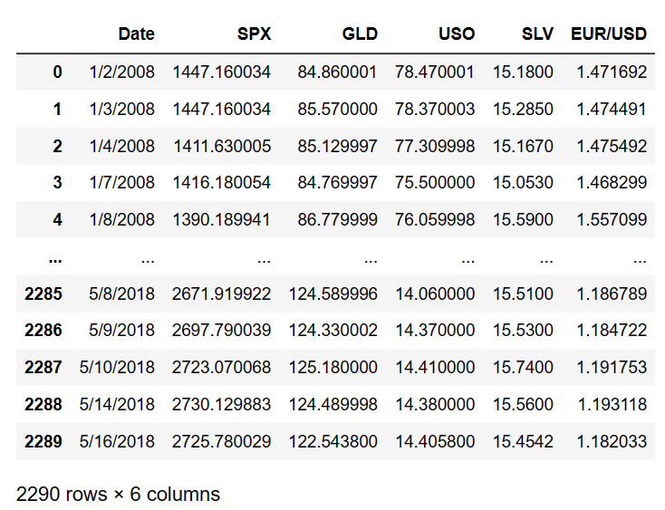
CSV file
gld_price_data

Slide 7
Libraries:
Pandas : For data analysis.
Numpy : For numeric calculation.
Matplotlib : For data visualization.
Seaborn : For making statistical graphics.
Sklearn :This module contains multiple libraries are having pre-implemented functions to perform tasks from data preprocessing to model development and evaluation.

Slide 8
Algorithms:
Linear Regression:
It is supervised ML model for evaluating data and establishing a definite relationship between two or more variables.
Random Forest Regressor:
It is an ensemble of decision trees, most of times with the bagging method. The general idea of the bagging method is that a combination of learning models increases the overall accuracy.
Support Vector Regression:
It is the type of SVM algorithm.It tries to find best prediction of continuous output values for a given input values.

Slide 9
Advantages:
Long term price stability.
Global Currency.
Fixed international exchange rates.
Stable investment tool.
Disadvantages:
Gold is limited so this may limit economy growth.
Growing economy need money supply to grow.

Slide 10
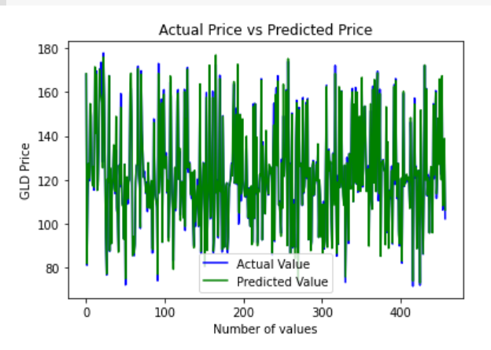
Conclusion :
By testing with different ML prediction models such as linear regression,Random forest regression and SVR it has been established that random forest comes out with better accuracy in predicting. By building web application it could benefit more number of people worldwide for better decisions for them.

Slide 11
Reference:
https://www.kaggle.com

Slide 12
THANK YOU!

